Slide 1
Olympic Data Analytics
Group 10
Prerak Panwar(30), Yi Hsiang Hung(17)

Slide 2
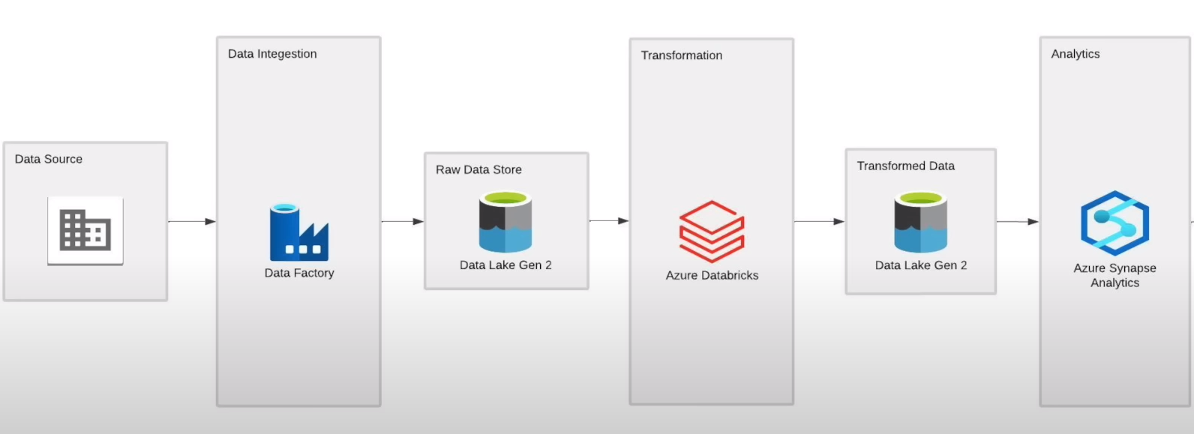
Architecture of the Project work:

Slide 3

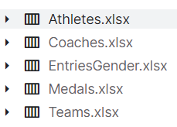

About Dataset:
Source of data : https://www.kaggle.com/datasets/arjunprasadsarkhel/2021-olympics-in-tokyo
Extracted data from Github Repository. Where the data is in CSV format.

Slide 4



Data Lake Storage Gen 2 (for Data Storage):
Data lake solution that combines the capabilities of a data lake with the power of Azure Blob Storage, allowing you to store and analyze large volumes of structured and unstructured data with enhanced performance, security, and analytics capabilities.
Data Lake
Gen 2
Data Lake
Gen 1
Storage Account

Slide 5
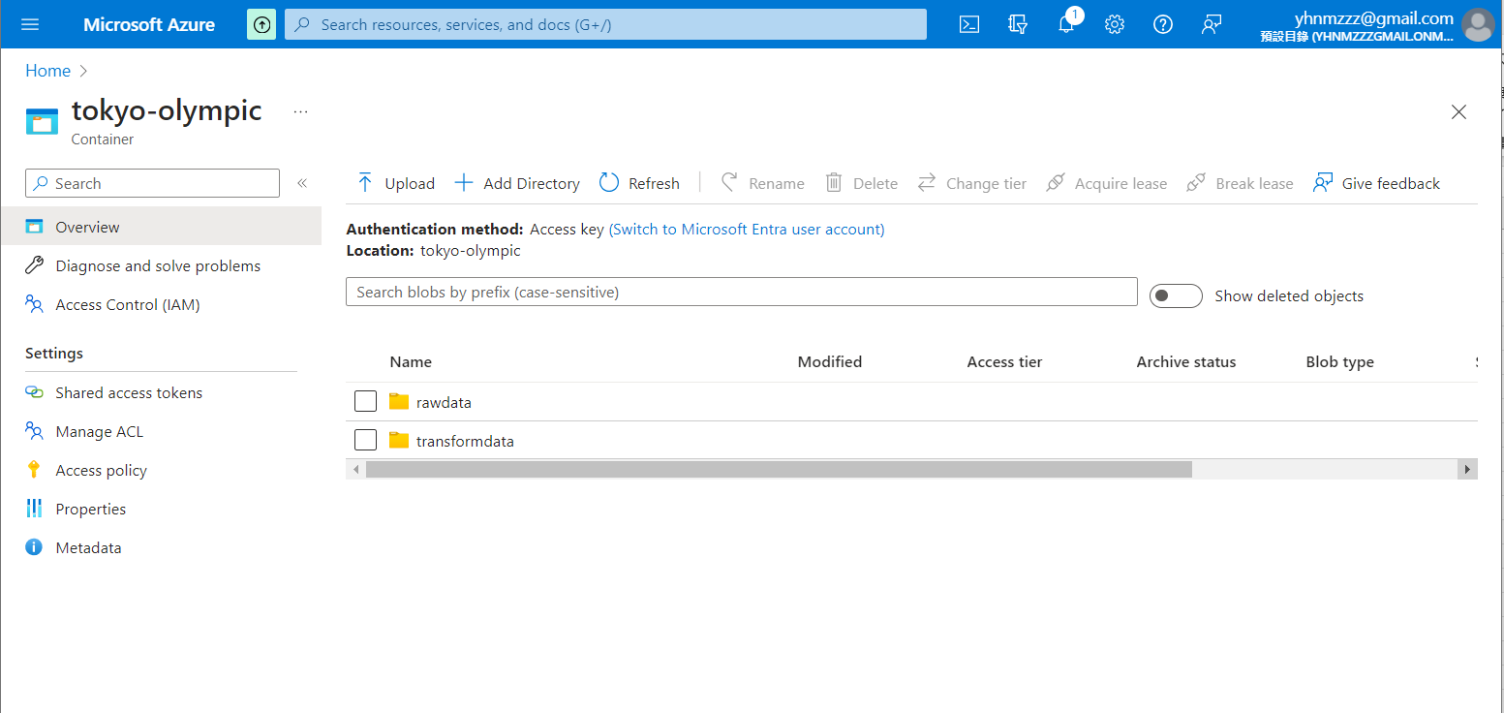
Data Lake Storage Gen 2:

Slide 6

Azure Data Factory (for Data Ingestion):
Data integration service that enables you to create, schedule, and manage data pipelines for efficient data movement and transformation between various sources and destinations in Azure and beyond. It simplifies ETL (Extract, Transform, Load) and data integration tasks.
Data Factory

Slide 7
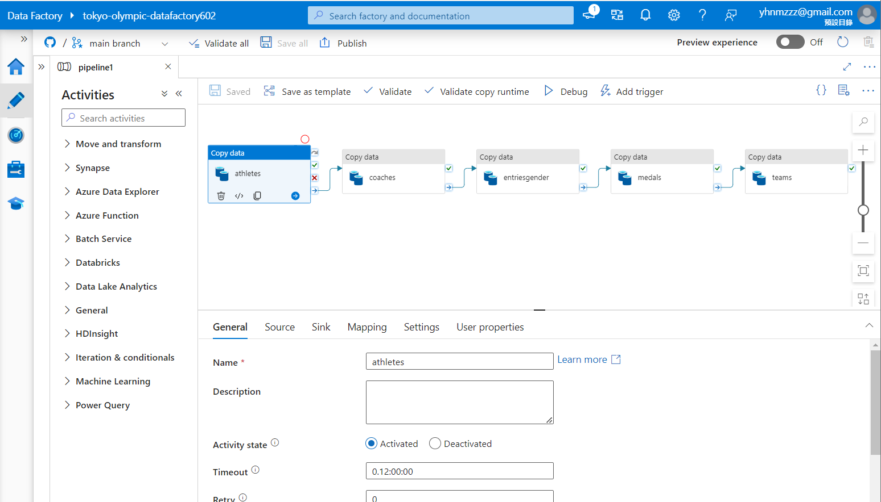
Azure Data Factory:

Slide 8

Azure Databricks (for Data Transformation)
Databricks is a unified analytics platform built on top of Apache Spark, designed to help data engineers and data scientists collaborate on big data processing and machine learning tasks. It provides tools for data exploration, data processing, and building machine learning models in a collaborative and scalable environment.
Databricks

Slide 9
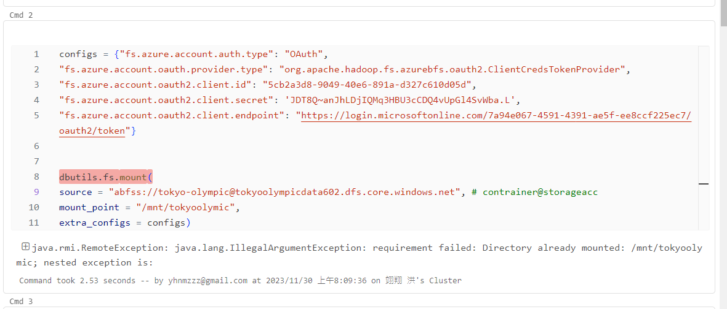
Azure Databricks - Authentication:

Slide 10
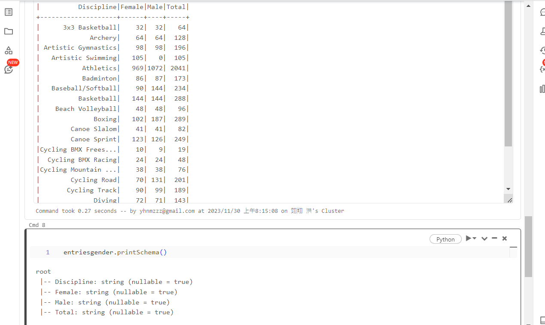
Azure Databricks - Transformation:

Slide 11
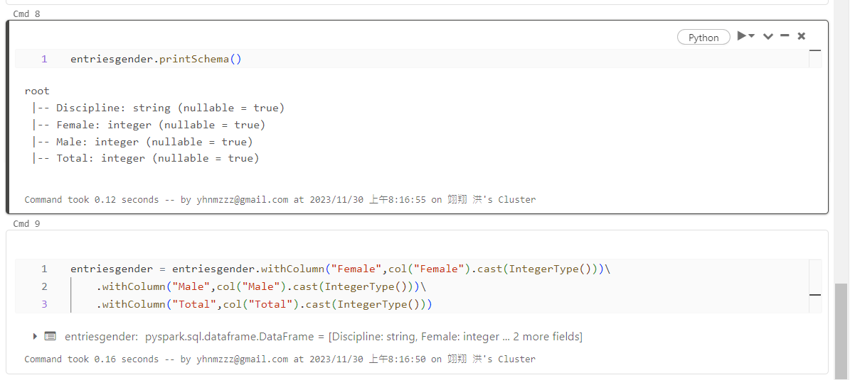
Azure Databricks - Transformation:

Slide 12

Azure Synapse Analytics (for Data Analysis)
SQL Data Warehouse is a cloud-based analytics service provided by Microsoft Azure. It combines big data and data warehousing into a single integrated platform, allowing organizations to analyze and process large volumes of data for business intelligence and data analytics purposes.
Synapse Analytics

Slide 13
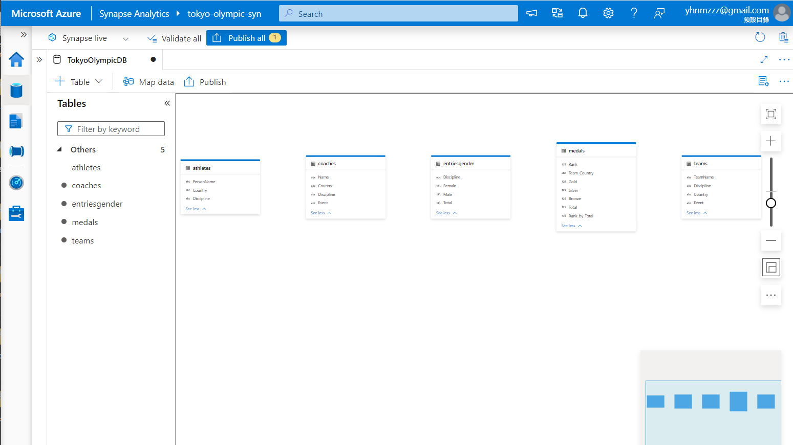
Azure Synapse Analytics:

Slide 14
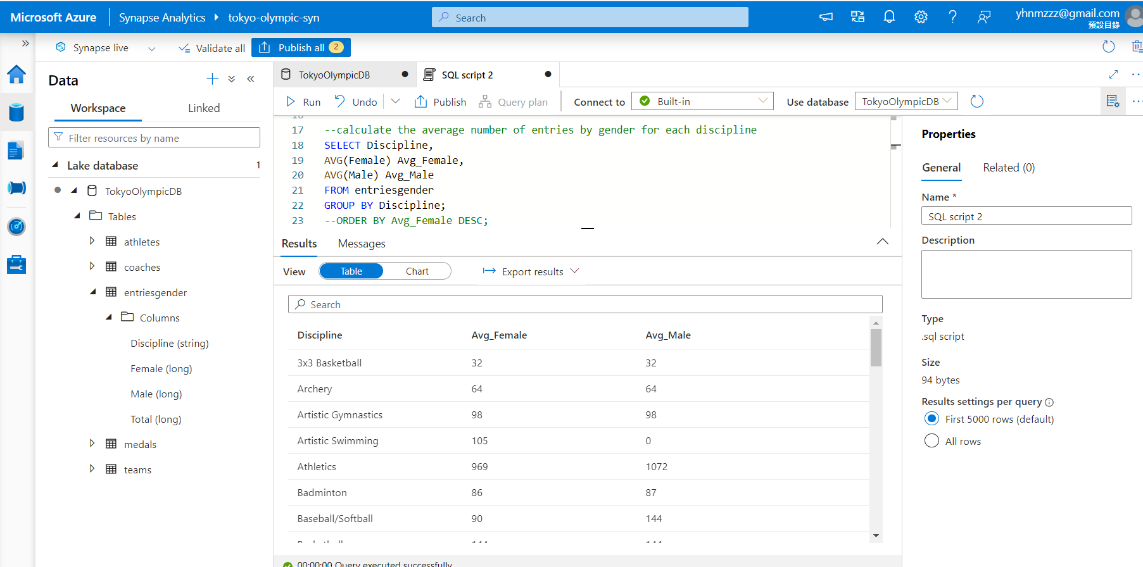
Azure Synapse Analytics:

Slide 15
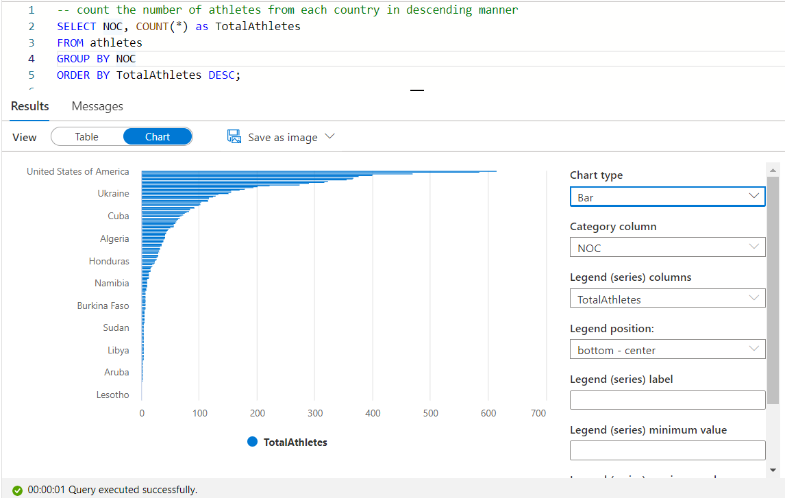
Azure Synapse Analytics - Visualizations:

Slide 16

Power BI (for Data Visualization)
Power BI is made up of three main components: the Power BI Desktop, the Power BI service, and the Power BI mobile app. It allows you to connect to a wide variety of data sources, including Excel, SQL databases, and cloud-based services, and create interactive charts, maps, and visualization.
Power BI

Slide 17
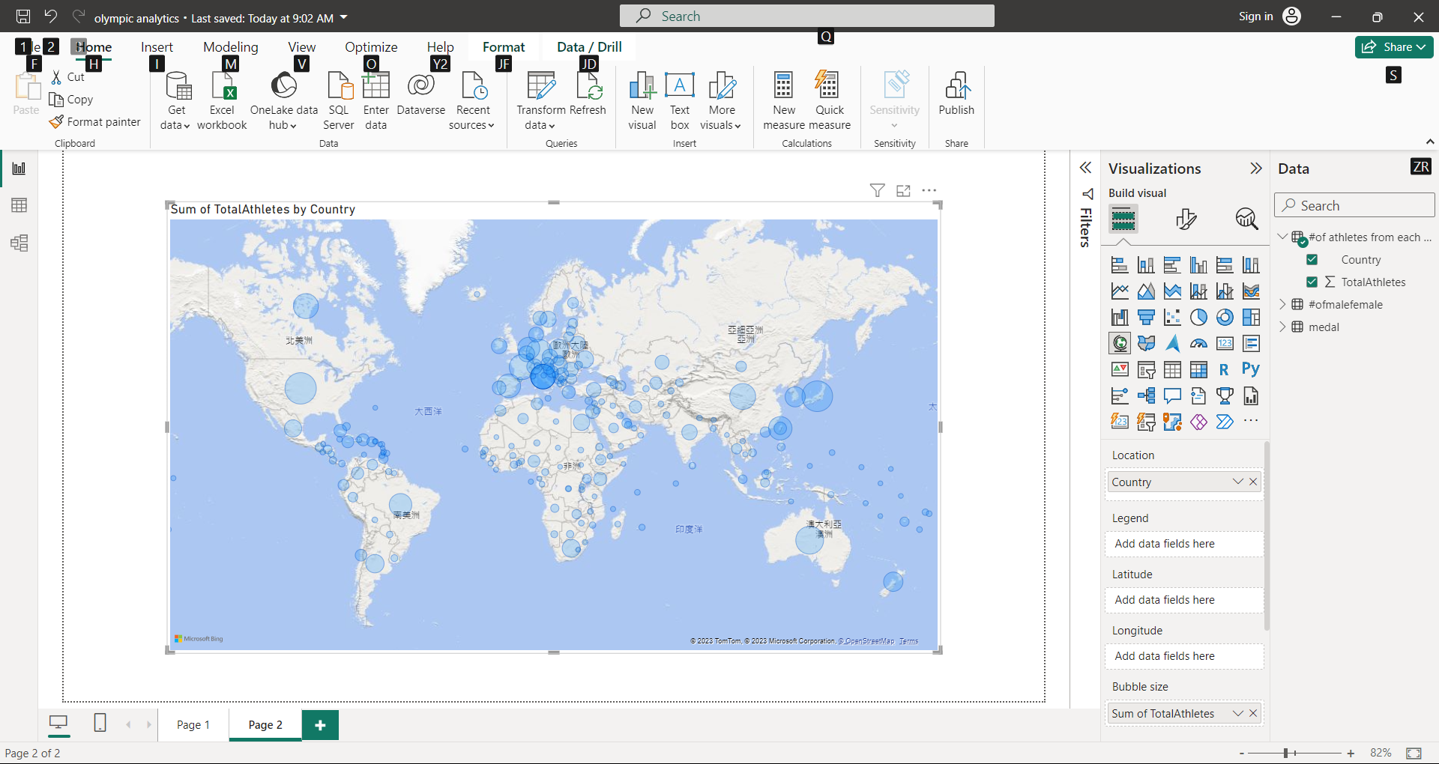
Microsoft Power BI - Visualization:

Slide 18
Thank you
Q&A

